Slide 1
Little
Website Development Project 2014
Johns
Lori Mann
Professor Eva Hamburger
DeVry University
10/18/14
Notes:
Hi,
Today we are going to cover the redesign of the Little Johns website.

Slide 2
CONTENTS
Project Description
Site Structure
Site Map
Website Diagram
Visual Design
4 Wireframe Samples
Home / About
Comfort Stations (Product Page)
Rentals
Contact Us
Typography
Font Family
Font Sizes
Color Codes
Headers & Links
Graphics / Multimedia
Logo
Social Media Icons
Sample images
Navigation
Base Navigation
Navigation Selected
Bread Crumb Trail
Notes:
The following slides will cover everything from the purpose of the website to the navigation and the color codes needed for the build. The main information components needed to complete this build are included in this slide deck.

Slide 3
Project Description
Requirements
Central, easy to use location of all company and product information
Primary site audience would be Local businesses, schools and event planners
Suggest potential use cases for portable comfort stations
Provide access to social media sites and contact options
(address, phone, email, contact form)
Include a manual rotate image window box on product pages
with up to 4 alternate images
Include a random rotating single comment section
Include advertisement / promotion section
Update from central location to populate all pages
Notes:
The purpose of this redesign is to make the website easier to use for customers. By implementing a custom template for the site within a CMS the owner will be able to update the few things that may need updated. The planning and design should take up no more than half of the production time of the project. The owner and a few key employees will review the plans, designs and site operation at key intervals in the build process to make sure the site meets their needs.

Slide 4
Project Description
Not Needed
Reservation and order system are not needed
Strict control over inventory usage and availability
Contracts need signed
Correct quantity needs per event
No Flash animations or multimedia are needed
May add videos at later date
Notes:
A reservation or online order system is not needed since customers have to sign a contract and make a deposit in order to reserve for an event. This also allows Little Johns operators to make sure that the correct quantity is ordered for customers events. At this time they don’t want to add any videos to the site; however this could be a possibility at a later date.

Slide 5
Site Structure
Site Map
Home
About Us
Comfort Stations
Events
Premium Comfort Station
Standard Comfort Station
ADA Comfort Station
Hand Wash Station
Worksite
Standard Comfort Station
ADA Comfort Station
Hand Wash Station
Rentals
Contact Us
Search
FAQ’s
Six (6) main topics
Two (2) Sub-topics
Four Products
Notes:
As can be seen in this slide the site will contain six (6) main items or sections with subsections for the products. The seventh topic will be an advanced search page. The products themselves will fall into two (2) different categories; however the individual product pages will be shared between the two (2) categories. This interaction will be more clear on the Site diagram on the next slide.

Slide 6
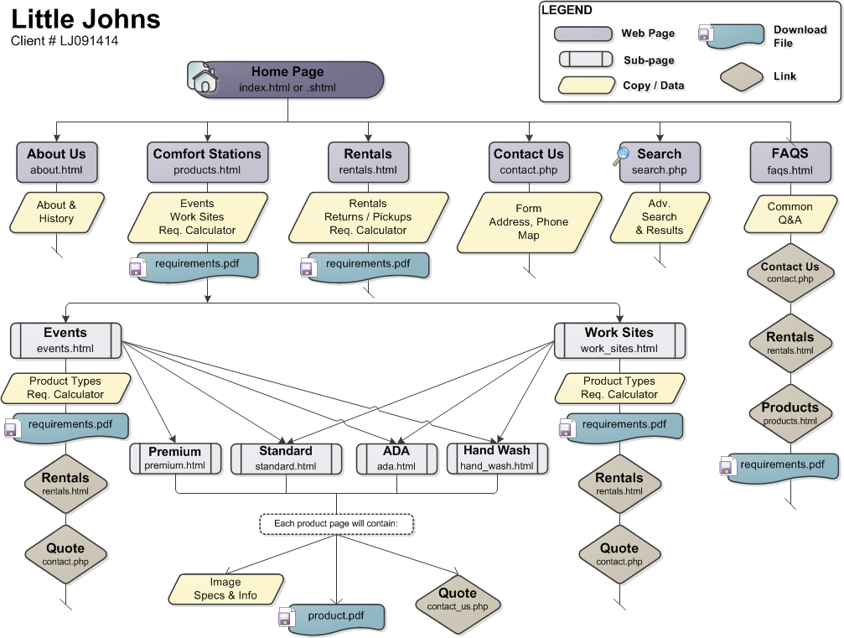
Site Structure
Website Diagram
Notes:
As you can see we have an extensive usage diagram for reference which should help with the layout of the site. The main navigation is given with the highlights of each page. All link locations to the requirements pdf file as well as the file name are shown. There is a legend available for quick identification of each diagram item.

Slide 7
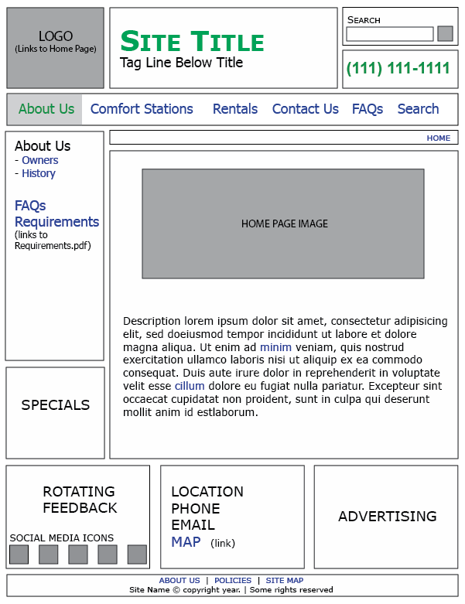
Visual Design
Wireframe 1 – Home / About Us
Home page will double as the About Us Page
2 sub pages
Owners and /or staff
History
Notes:
There are 4 wireframe samples included in this slide deck and each displays the same basic, consistent look, feel and layout. The special will be consistent across all pages. The advertising should rotate on page loads so each page may have a different ad. The rotating feedback should contain a single quote that rotates on page load as well. The footer will include two sub-pages for site policies and site map.

Slide 8
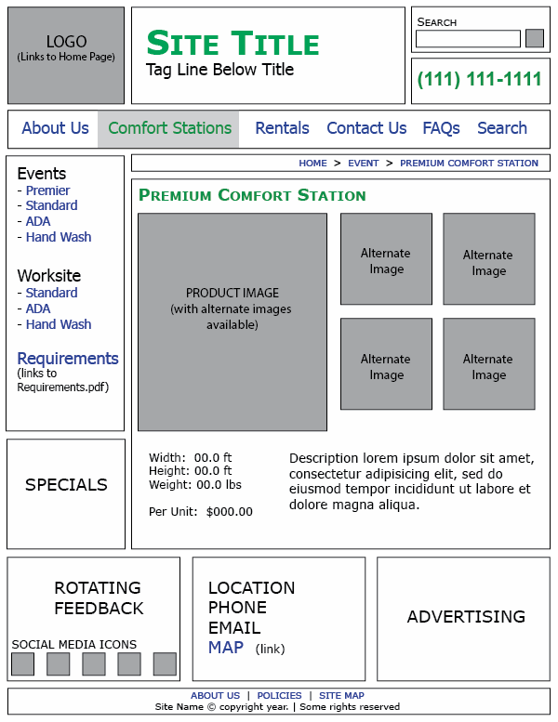
Visual Design
Wireframe 2 – Product Page
1 main image
4 alternate images
5 Thumbnails
Include
Dimensions
Include cost per
Include description
Notes:
The product pages will have a single large product in a manual rotating window box and four alternate images. The alternate images will be accessed by clicking on their thumbnails.

Slide 9
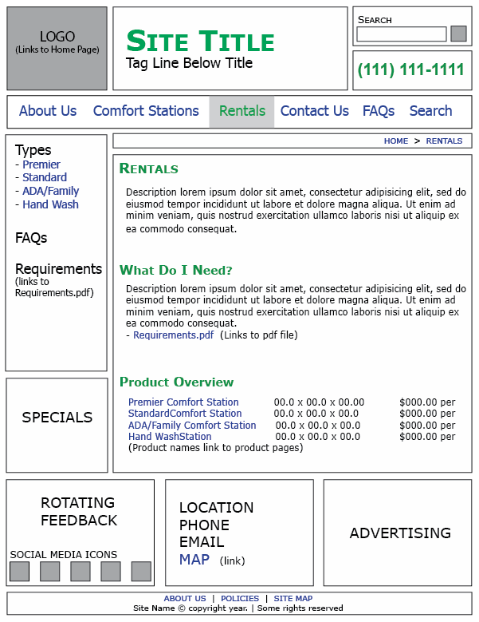
Visual Design
Wireframe 3 – Rentals
General Rental Information
Next Steps
Determine requirements for an event
Product overview
Include dimensions
Include cost per
Link to product pages
No images
Notes:
The rentals page will include general information regarding renting, next steps and product overviews without images. Each product listed should link to the actual product page.

Slide 10
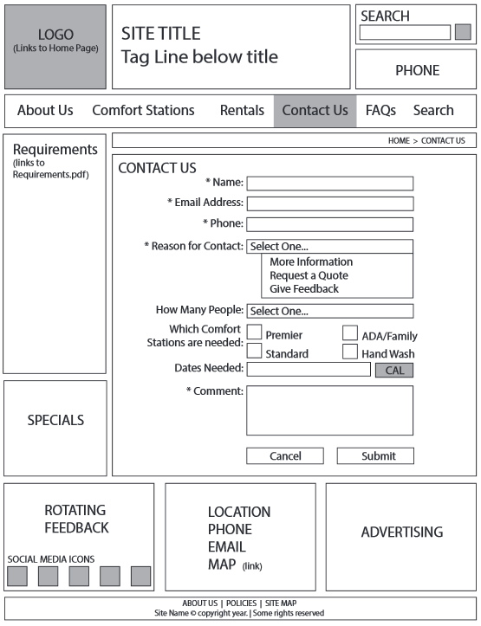
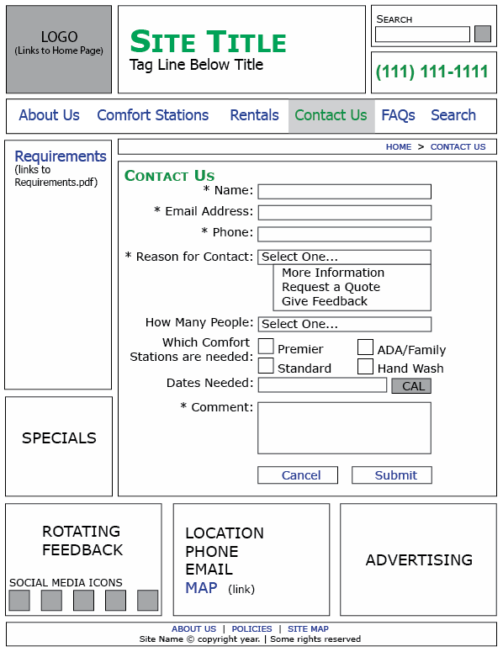
Visual Design
Wireframe 4 – Contact Us
Standard form setup
Combines three (3) forms in one
Contact Us
Request a Quote
Feedback
Pop out Calendars should be included for “Dates Needed”
Captcha or ReCaptcha should be implemented
Notes:
As you can see here there will only be a single form on the site and it will pull triple duty by including the contact, quote and feedback into the single form.

Slide 11
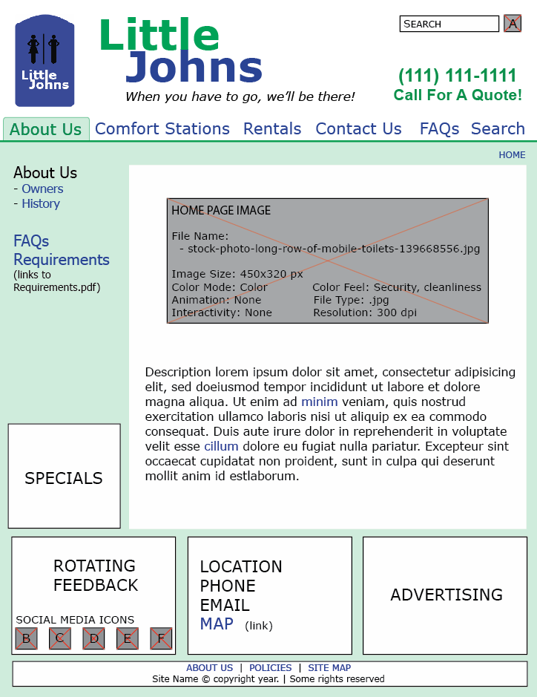
Typography
Overview
Notes:
“Little Johns” maintains a medium blue and medium green color scheme for their branding which is applied to links, headers, titles, and navigation. The main copy will remain black and the same pale green color that appears behind the active navigation, will be carried through as the background for the page below the navigation. This presents a clean and consistent style.

Slide 12
Typography
Font Information
Font Family
Verdana, Tahoma, sans-serif
Font Size, Color and Color Samples
Header
Little: | 48 pt | bold | #00FF00
Johns: | 48 pt | bold | #0019FF
Tag Line: | 14 pt | italic | #000000
Phone: | 21 pt | bold | #00FF00
Call Quote: | 18 pt | bold | #00FF00
Copy
Copy: | 14 pt | normal | #000000
Copy Links: | 14 pt | underline | #0019FF
Navigation
Base: | 18 pt | normal | #0019FF
Active: | 18 pt | normal | #00FF00
Sub-Navigation
Titles: | 18 pt | bold | #000000
Title Links: | 18 pt | Bold | #0019FF
Sub-Title Links: | 14 pt | normal | #0019FF
Sub-Title Active: | 14 pt | normal no dash | #00FF00
Notes:
As you can see here the font information, color codes and most of the font styles are listed here for reference. What is provided in this chart should provide enough of a base to fill in any potential gaps.

Slide 13
Graphics & Multimedia
Little Johns Logo & Title
File Name: | Little-Johns-Logo.png
File Size: | 6.48 kb
Image Size: | 162 x 240 px
Color Mode: | Color, RGB
Color Feel: | Warm, security
Animation: | None
Interactivity: | Links to Home Page
File Type: | .png
Resolution: | 72 dpi
Copyright: | Lori Mann
Link or Process: | Created in Photoshop using shape, pen and text tools
Notes:
The Little Johns logo should be approximately the same height as the Little Johns header. The header can either be an image or text as long as the same format that is seen here is maintained. This means “Little” should fall above “Johns” and they should line up with the L and H characters. The tag line will then line p with the left edge of “Johns”.

Slide 14
Graphics & Multimedia
Search Icon
File Name: | Search-icon_24.png
File Size: | 4 kb
Image Size: | 24x24 px
Color Mode: | Color, RGB
Color Feel: | curiosity
Animation: | None
Interactivity: | Submit button
File Type: | .png
Resolution: | 72 dpi
Copyright: | Zerode Free for non-commercial use
Link or Process: | http://www.iconarchive.com/show/plump-icons-by-zerode/Search-icon.html
Notes:
The search icon is to be used with the search bar, replacing the normal GO button. It is free for commercial use and will need converted to a smaller size for use.

Slide 15
Graphics & Multimedia
Social Media Icons
File Names: | LJ_Email.png LJ_RSS.png LJ_Twitter.png LJ_Linkedin.png LJ_Facebook.png
File Size: | 3 kb
Image Size: | 35x35 px
Color Mode: | Color, RGB
Color Feel: | Security, loyalty
Animation: | None
Interactivity: | Links to each social media account or opens an email
File Type: | .png
Resolution: | 72 dpi
Copyright: | Geek Fairy | March 7, 2014 Use in Personal & commercial projects; no attribution required
Link or Process: | http://geekfairy.co.uk/free-purple-rimmed-circle-social-media-icons/ http://geekfairy.co.uk/license-agreement/
Notes:
These are the social media icons to be used with the site. These icons are actually free to use and available for commercial use. The color works well with the site branding and should appear at a size of 35 x 35 pixels. Of this group we will currently be using the icons for Email, Twitter, Facebook, RSS, and LinkedIn; however the owner would like all of the icons converted for use on the site for potential use at a later date.

Slide 16
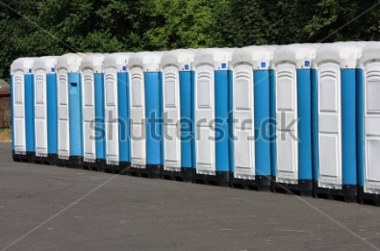
Graphics & Multimedia
Home Page Image
File Name: | stock-photo-long-row-of-mobile-toilets-139668556.jpg
File Size: | 48.2 kb
Image Size: | 450 x 320 px
Color Mode: | Color, RGB
Color Feel: | Security, cleanliness
Animation: | None
Interactivity: | None
File Type: | .jpg
Resolution: | 300 dpi
Copyright: | Shutter stock - Peter Gudella Image ID: 139668556
Link or Process: | http://www.shutterstock.com/pic-139668556/stock-photo-long-row-of-mobile-toilets.html?src=pp-same_artist-104368565-XJFZVKo43SXJMObJqlaIew-1
Notes:
This is the image chosen for the home page. We actually have a couple options here. We can include a single static image, a random image that rotates on page load or a slide show of a few images. The owner is open to all three options as long as the image(s) fit within the area allotted. Images should be in color and at a size of approximately 450 x 320 pixels.

Slide 17
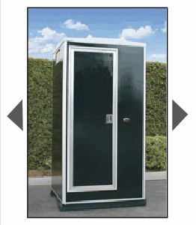
Graphics & Multimedia
Product Image / Window Box
File Name: | Premium_Comfort_Station.jpg
File Size: | 14.1 kb
Image Size: | 157 x 235 px
Color Mode: | Color, RGB
Color Feel: | Security, healing, comfort
Animation: | None
Interactivity: | Arrows allow image change
File Type: | .jpg
Resolution: | 96 dpi
Copyright: | National Construction Rentals
Link or Process: | http://www.rentnational.com/vip-solar-restrooms.aspx
Notes:
The large product images should all be in color and the same size of approximately 157 x 235 pixels. These images will appear in the manual rotate window box and there should be one large image per thumbnail.

Slide 18
Graphics & Multimedia
Alternate Image Thumbnails
tn_premier_1.jpg 7.24 kb | tn_premier_2.jpg 5.99 kb | tn_premier_3.jpg 6.52 kb | tn_premier_4.jpg 7.56 kb
All alternate images should be in color and at a size of 100x100 pixels. Each image would be a link to the full size image that will appear in the window box. Each product page should have four (4) alternate image thumbnails.
Image Size: | 100 x 100 px
Color Mode: | Color, RGB
Color Feel: | Color
Animation: | None
Interactivity: | Click to appear in window box
File Type: | .jpg
Resolution: | 72 dpi
Copyright: | National Construction Rentals
Link or Process: | http://www.rentnational.com/vip-solar-restrooms.aspx
Notes:
Each product page should include four (4) alternate images for each item. The sizes should be as small as possible to accommodate fast load times and the quality should be clear. The thumbnails should be created from the full size images. Each thumbnail will link to the full size image that will appear in the main window box.

Slide 19
Navigation
Base Navigation
The base navigation should be located just below the header on every page of the site and does not change locations. The items or “tabs” should span the page with equal amounts of space between each item and should retain the same position across all pages. There should be a 20 pixel gutter on both sides of the page with a 5 pixel margin between the links and the border.
Font: | Verdana
Font Size: | 18 pt
Link Color: | #0019FF (Blue)
Border: | #00FF00 (Green)
Border Size: | 3 pixel height 100% width
Notes:
This site will utilize a standard static navigation with text links. HTML and CSS will create rollovers to indicate the selected states within the menu. The next 3 slides will detail information needed for the base navigation, selected navigation, sub-navigation and bread crumb trail.

Slide 20
Navigation
Navigation Selected
An image would be considered an acceptable compromise for the tab in order to retain a consistent look across all browsers. The 20 pixel gutter on both sides of the navigation would remain in affect.
Font: | Verdana
Font Size: | 18 pt
Link Color: | #0019FF (Blue)
Border: | #00FF00 (Green)
Border Size: | 3 pixel height 100% width
Tab Color: | #00FF00 (Green) 20% Opacity
Notes:
When selecting an item or link a green tab will appear behind the selected link to indicate the active page. This will occur as a rollover and as a fixed tab to indicate the active selection. By using HTML and CSS the navigation rollover will degrade nicely for older browsers while still retaining a tab shape behind the link.

Slide 21
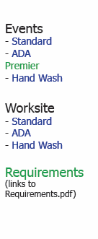
Navigation
Selected Navigation with Sub-Navigation
if a sub-navigation is needed for that tab selection it will appear down the left side of the page (sample below). Section titles will be black and links will remain in the blue color carried throughout the site. Actively selected pages will appear left aligned and green in color.
Font: | Verdana
Font Size: | 18 pt
Link Color: | #0019FF (Blue)
Border: | #00FF00 (Green)
Border Size: | 3 pixel height 100% width
Tab Color: | #00FF00 (Green) 20% Opacity
Notes:
When sub-navigation is needed for a selection it will appear down the left side of the page. Section titles will be black and links will remain in the blue color carried throughout the site. Actively selected pages will appear left aligned and green in color. Regardless of the page actively selected a green tab will appear behind pages group tab. In the example below the page is for the Premium Comfort Station. The main Comfort Station tab is highlighted and Premier is green in the left sub-navigation.

Slide 22
Navigation
Bread Crumb Trail
The breadcrumb trail should be just under the main navigation and aligned with the right side of the page. There should be a 20 pixel gutter on the right edge with a 3-5 pixel margin on the top and bottom.
Font: | Verdana
Font Size: | 10 pt
Link Color: | #0019FF (Blue)
Separator: | > (&gt;)
Separator Size: | 10 pt
Separator Color: | #000000 (Black)
Notes:
The breadcrumb trail indicates what the active page is and what tab it falls under. As you can see this slide details where the breadcrumb should be located as well as some of the specific information regarding its formatting.

Slide 23
If you have any questions please contact:
?
QUESTIONS
?
COMMENTS
?
Lori Mann (123) 456-7890 | lori.mann@littlejohns.com
Notes:
If you have any questions, comments or issues regarding the site development please feel free to reach out to me. This slide deck will be made available to all members of the team after this meeting.
Thank you!

Slide 24
Image References 1
Alternate Image Thumbnails
File Name 1: tn_premier_1.jpg
File Name 2: tn_premier_2.jpg
File Name 3: tn_premier_3.jpg
File Name 4: tn_premier_4.jpg
Reference: http://www.rentnational.com/vip-solar-restrooms.aspx
Home Page Image
File Name: stock-photo-long-row-of-mobile-toilets-139668556.jpg
Reference: http://www.shutterstock.com/pic-139668556/stock-photo-long-row-of-mobile-toilets.html?src=pp-same_artist-104368565-XJFZVKo43SXJMObJqlaIew-1
Logo
File Name: Little-Johns-Logo.png
Reference: Lori Mann © 2014 Created in Photoshop using shape, pen and text tools

Slide 25
Image References 2
Product Image / Window Box
File Name 1: tn_premier_1.jpg
File Name 2: tn_premier_2.jpg
File Name 3: tn_premier_3.jpg
File Name 4: tn_premier_4.jpg
Reference: http://www.rentnational.com/vip-solar-restrooms.aspx
Search Icon
File Name: stock-photo-long-row-of-mobile-toilets-139668556.jpg
Reference: http://www.shutterstock.com/pic-139668556/stock-photo-long-row-of-mobile-toilets.html?src=pp-same_artist-104368565-XJFZVKo43SXJMObJqlaIew-1
Social Media Icons
File Name: Little-Johns-Logo.png
Reference: Lori Mann © 2014 Created in Photoshop using shape, pen and text tools

